Slide 1
MAC Protocols

Slide 2
Multiple Access Protocols
Multiple Access Protocols—by which nodes regulate their transmission into the shared broadcast channel.
Multiple Access Protocols are needed in a wide variety of network settings, including both wired and wireless access networks, and satellite networks.

Slide 3
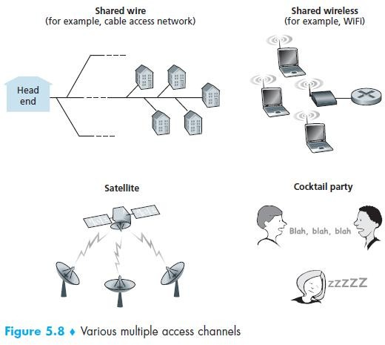
Multiple Access Protocols

Slide 4
Multiple Access Protocols
A multiple access protocol for a broadcast channel of rate R bits per second should have the following desirable characteristics:
  1. When only one node has data to send, that node has a throughput of R bps.
  2. When M nodes have data to send, each of these nodes has a throughput of R/M bps. This need not necessarily imply that each of the M nodes always has an instantaneous rate of R/M, but rather that each node should have an average transmission rate of R/M over some suitably defined interval of time.

Slide 5
Multiple Access Protocols
3. The protocol is decentralized; that is, there is no master node that represents a single point of failure for the network.
4. The protocol is simple, so that it is inexpensive to implement.

Slide 6
Multiple Access Protocols
There are three categories:
  Channel partitioning protocols,
  Random access protocols, and
  Taking-turns protocols.

Slide 7
Channel Partitioning Protocols
There are two techniques that can be used to
partition a broadcast channel’s bandwidth among all nodes sharing that channel.
  Time-Division Multiplexing (TDM) and
  Frequency-Division Multiplexing (FDM)
In TDM:
  Suppose the channel supports N nodes and that the transmission rate of the channel is R bps.
  TDM divides time into time frames and further divides each time frame into N time slots.

Slide 8
Channel Partitioning Protocols
Each time slot is then assigned to one of the N nodes.
Whenever a node has a packet to send, it transmits the packet’s bits during it assigned time slot in the revolving TDM frame.
Typically, slot sizes are chosen so that a single packet can be transmitted during a slot time.
In FDM:
  FDM divides the R bps channel into different frequencies (each with a bandwidth of R/N) and assigns each frequency to one of the N nodes.
  FDM thus creates N smaller channels of R/N bps out of the single, larger R bps channel.

Slide 9
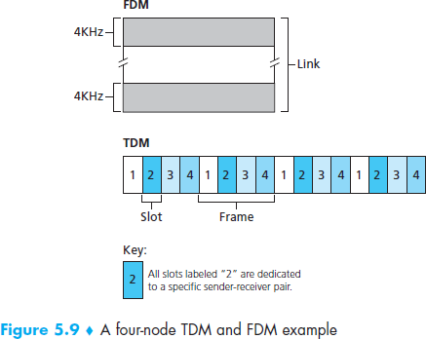
Channel Partitioning Protocols

Slide 10
Channel Partitioning Protocols
code division multiple access (CDMA):
While TDM and FDM assign time slots and frequencies, respectively, to the nodes, CDMA assigns a different code to each node.
Each node then uses its unique code to encode the data bits it sends.
CDMA networks have the wonderful property that different nodes can transmit simultaneously.

Slide 11
Random access protocols
In a random access protocol, a transmitting node always transmits at the full rate of the channel, namely, R bps.
When there is a collision, each node involved in the collision repeatedly retransmits its frame (that is, packet) until its frame gets through without a collision.
But when a node experiences a collision, it doesn’t necessarily retransmit the frame right away.
Instead it waits a random delay before retransmitting the frame.

Slide 12
Random access protocols
The ALOHA protocols:
  ALOHA
  Slotted ALOHA
The carrier sense multiple access (CSMA) protocols:
  CSMA with collision detection (CSMA/CD) protocols.
  CSMA with collision avoidance (CSMA/CA) protocols.
Details:-
  Data Communications and Networking
  By- B. A. Forouzan.
  3rd Edition, Chap-13th , Page: 311

Slide 13
Taking-Turns Protocols
The polling protocol:
  The polling protocol requires one of the nodes to be
designated as a master node.
  The master node polls each of the nodes in a round-robin
fashion.
  In particular, the master node first sends a message to node 1, saying that it (node 1) can transmit up to some maximum number of frames.
  After node 1 transmits some frames, the master node tells node 2 it (node 2) can transmit up to the maximum number of frames.
  The procedure continues in this manner, with the master node polling each of the nodes in a cyclic manner.

Slide 14
Taking-Turns Protocols
The token-passing protocol:
  A small, special-purpose frame known as a token is exchanged among the nodes in some fixed order.
  For example, node 1 might always send the token to node 2, node 2 might always send the token to node 3, and node N might always send the token to node 1.
  When a node receives a token, it holds onto the token only if it has some frames to transmit; otherwise, it immediately forwards the token to the next node.

Slide 15
Address Resolution Protocol (ARP)
Internet IP addresses and link-layer addresses (MAC addresses) both are network-layer addresses and there is a need to translate between them. For the Internet, this is the job of the Address Resolution Protocol (ARP)
Details:-
  Data Communications and Networking
  By- B. A. Forouzan
  3rd Edition, Page: 514

Slide 16
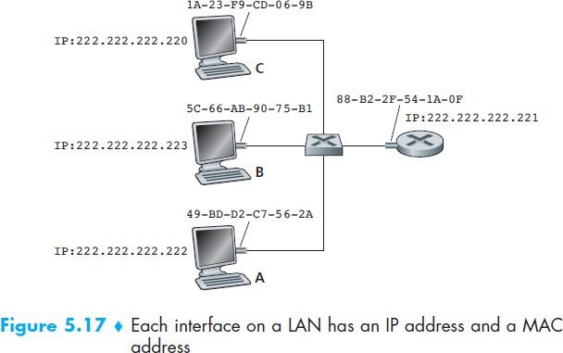
Address Resolution Protocol (ARP)

Slide 17
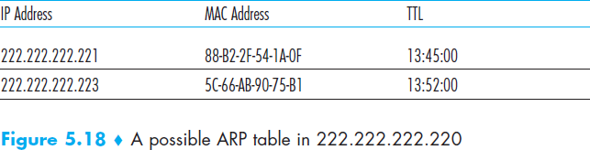
Address Resolution Protocol (ARP)

Slide 18
END

